Slide 1


STEPSMART
Your Step To Success
Telephone
Email
Website
Aug 2025
Your Step To Success
+91 - 9790464269 +91 - 9766704926
administrator@stepsmart.net
www.stepsmart.net
Notes:
add a photo (background fading)
one pager
font consistent check
alignments
all formating check

Slide 2
THE FUTURE YOU WERE PROMISED NO LONGER EXISTS
Over 100,000+ tech jobs have been eliminated in 2025 alone
50% of entry-level tech jobs have vanished since 2020
83% of India's unemployed workforce is aged 15-29

Slide 3
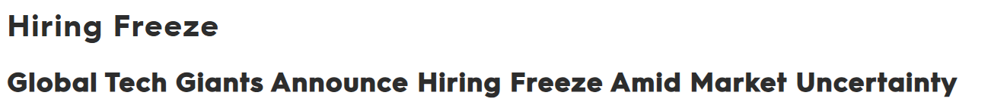
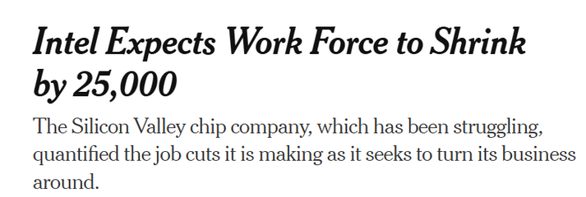
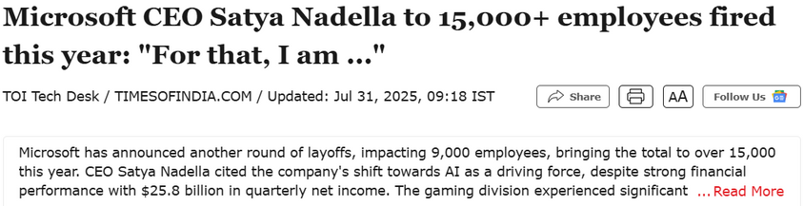
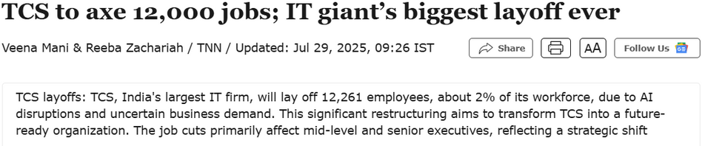
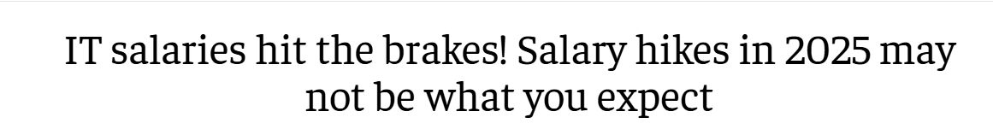
SOME RECENT NEWS

Slide 4
IS THERE DECLINE IN JOBS IN THE MARKET ?

Slide 5
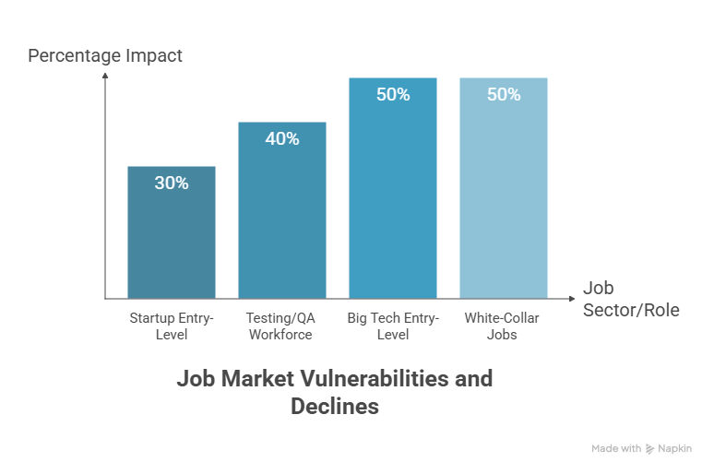
AUTOMATION RISK

Slide 6
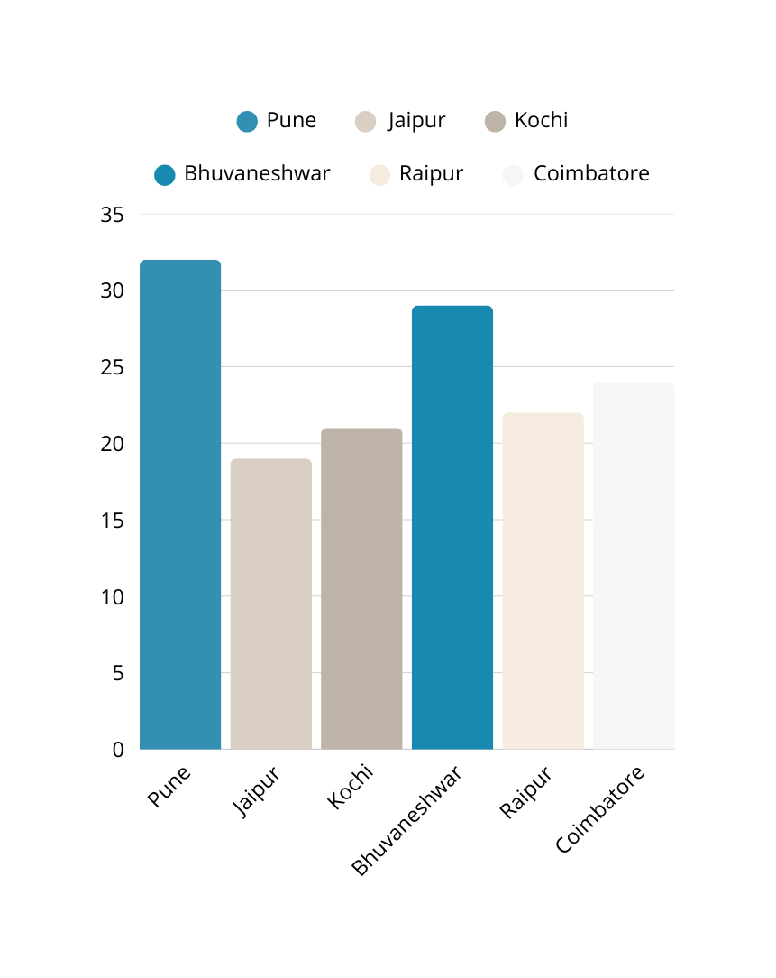
+ IMPACT OF AI
AI & Emerging Tech: 30–35% projected growth in AI/ML, data analytics, and cloud roles.
Critical Tools: Productivity & collaboration (83%), project management (73%), data visualization (64%).
Top Freshers Roles in H1 2025: AI Engineer, RPA Developer, Prompt Engineer, Network Security Analyst, Product Analyst.
Skill-First Focus: Prioritize AI, data analytics, cloud and RPA certifications; blend with strong soft skills.
Career Positioning: Demonstrate hands-on project experience and tools proficiency to offset employability gaps.
Notes:
1. Software Testing
Reduction:
Manual Testers — AI-driven testing tools (like Testim, Mabl) can automatically generate, run, and update test scripts, reducing the need for repetitive manual QA work.
Increase:
AI Test Automation Engineers — Specialists who train AI models for test coverage and integrate them into CI/CD pipelines.

Slide 7
WHY PREP IS CRITICAL
Structural changes in system (entire job categories finished - akin to industrial revolution)
Speed of change is unprecedented (skills of today is not very useful tomorrow - new AI tools everyday)
Adaptability is necessary (Job security is now an illusion more than ever before)
Learning new skills is critical to adapt
Need to learn beyond books and college
Notes:
1. Software Testing
Reduction:
Manual Testers — AI-driven testing tools (like Testim, Mabl) can automatically generate, run, and update test scripts, reducing the need for repetitive manual QA work.
Increase:
AI Test Automation Engineers — Specialists who train AI models for test coverage and integrate them into CI/CD pipelines.

Slide 8
WHAT IS THE MOST IMPORTANT SKILL THAT LACKS IN STUDENTS DURING PLACEMENTS?

Slide 9
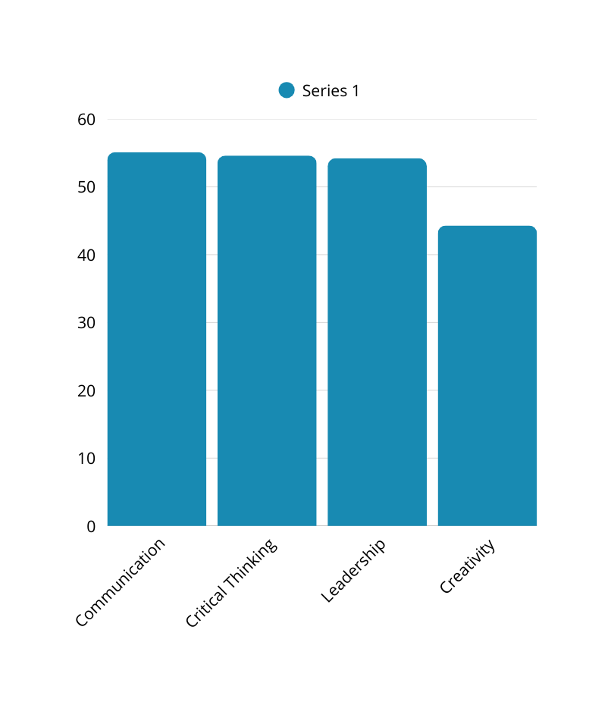
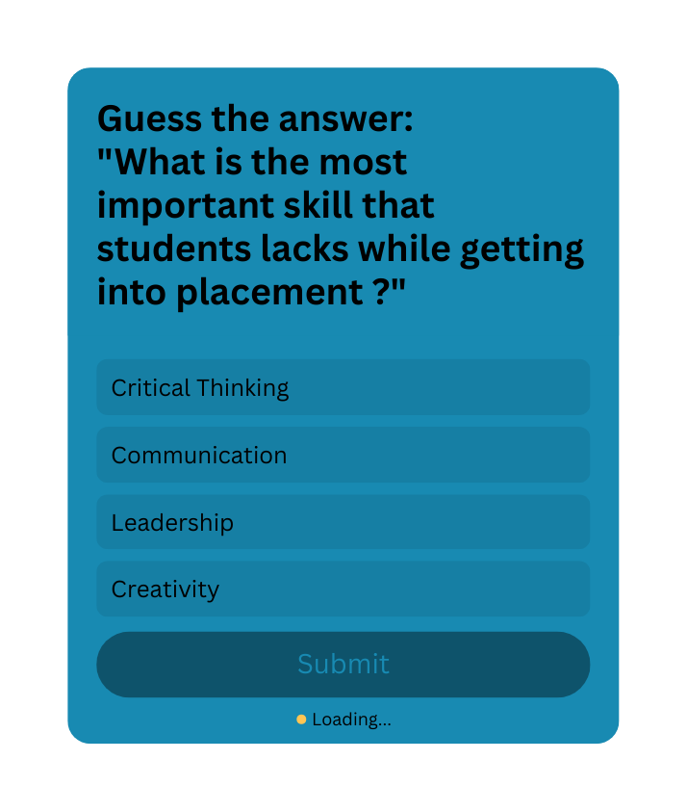
KEY STATISTICS
42.6% of Indian graduates are employable, down from 44.3% in 2023
Notes:
1. The Zomato-Style Résumé
Who: An aspiring marketing professional in India.
What they did: Designed their résumé to look exactly like a Zomato restaurant listing — complete with ratings, “delivery time,” “menu” of skills, “reviews” from ex-colleagues, and “special offers” (unique strengths).
Impact: Zomato’s HR team noticed it on LinkedIn and actually reached out, leading to interview calls.
Why it worked: Showed brand awareness, design skills, and humor in a format the company instantly related to.

Slide 10
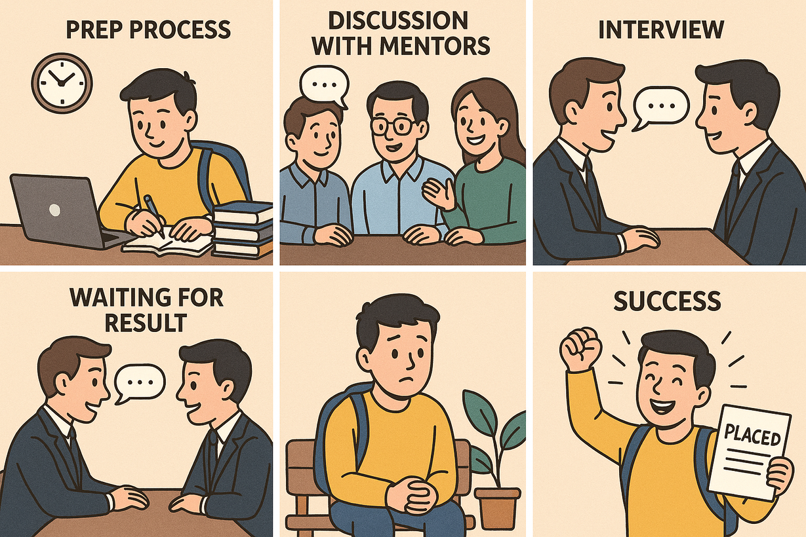
HOPE & BELIEF

Slide 11
WHAT IS YOUR FIRST IMPRESSION ON THE RECRUITER ?

Slide 12

LET’S GET INTO ACTION MODE
Stepping stone of your journey: Your Resume

Slide 13
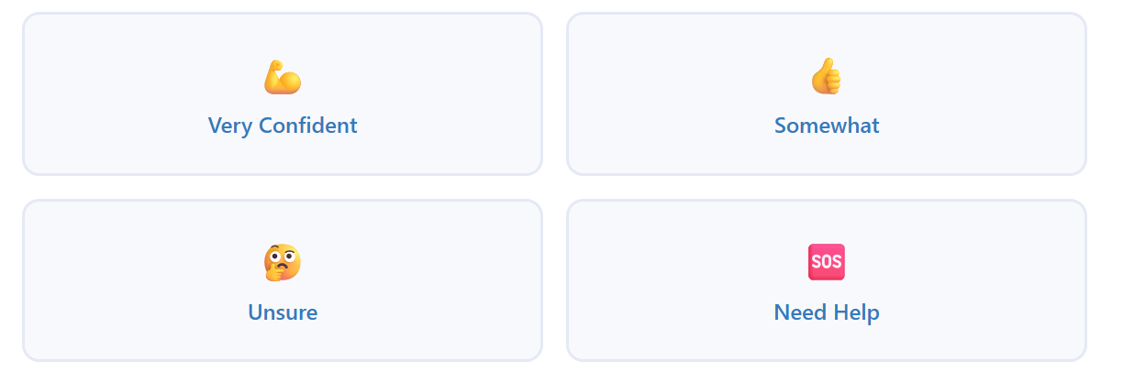
QUICK CHECK
How confident are you with your resume?

Slide 14
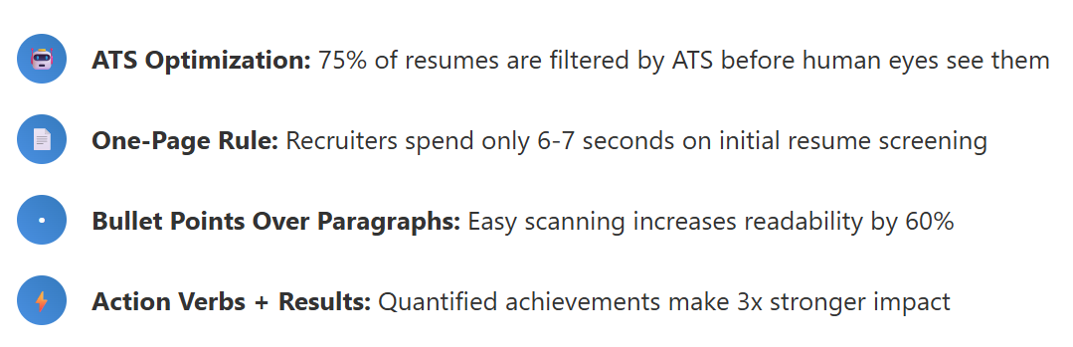
WHAT MAKES A MODERN RESUME EFFECTIVE?

Slide 15
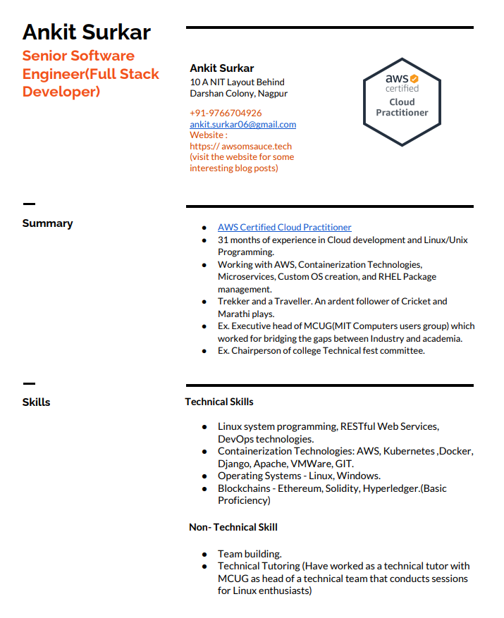
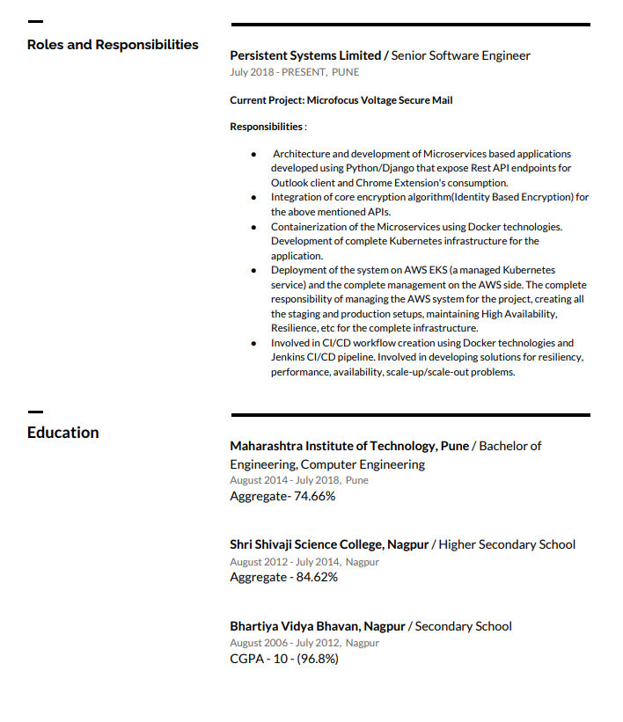
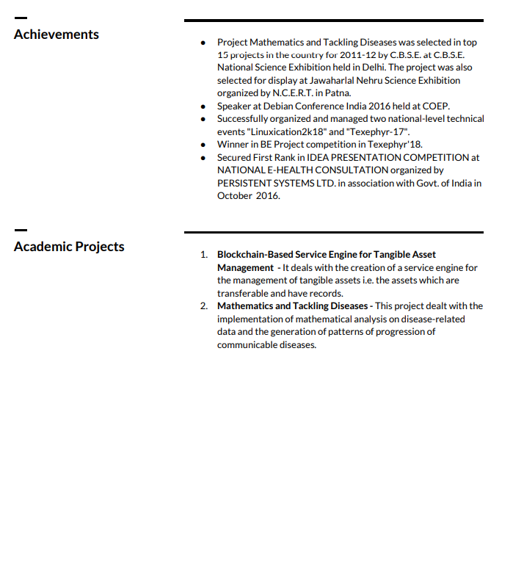
WHAT DO YOU THINK ABOUT?

Slide 16
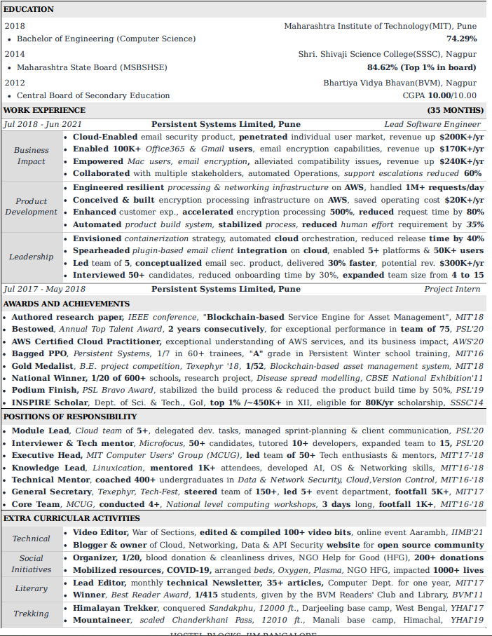
And...

Slide 17
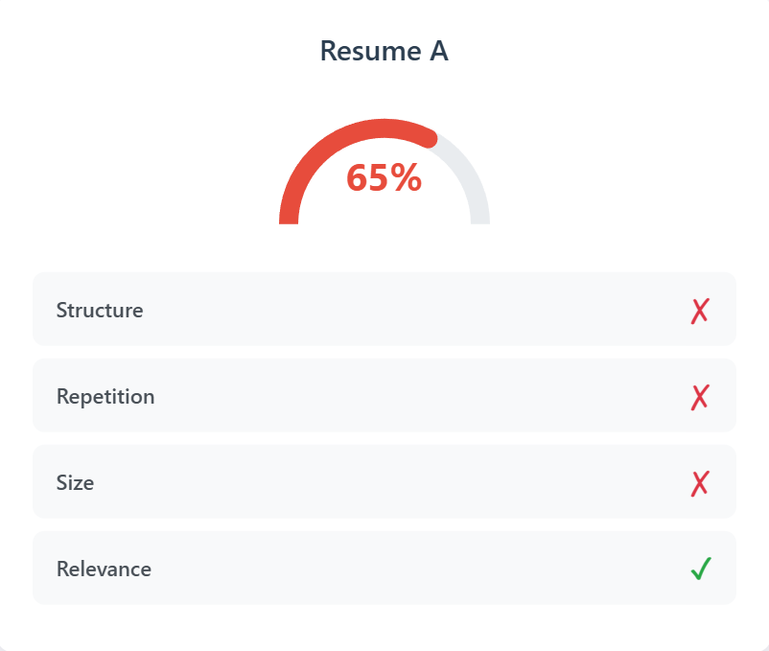
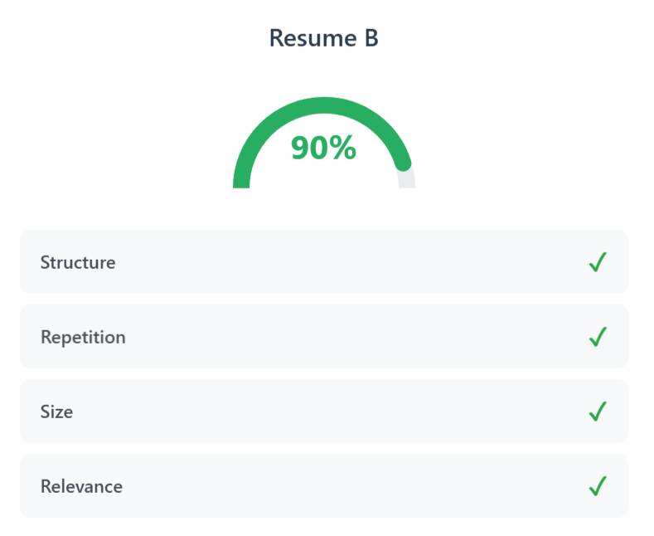
HOW AN ATS COMPARED THEM?

Slide 18
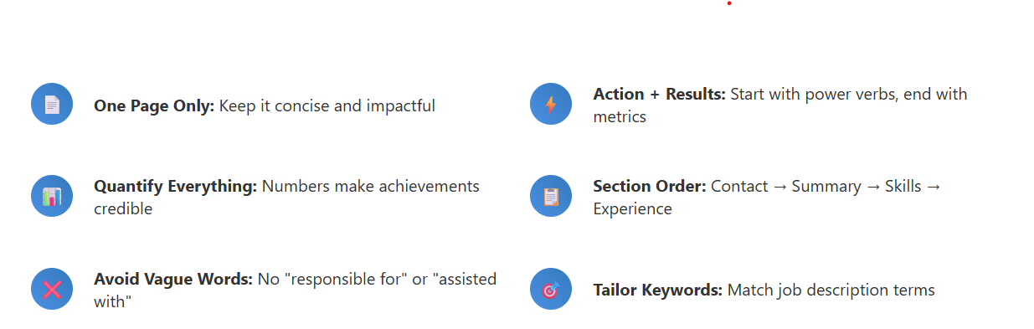
WHAT WOULD MAKE YOUR RESUME STANDOUT?

Slide 19
WHAT DO WE OFFER
Structured Pathways with Resources
Interview Preperation
Carefully crafted learning pathways tailored to each student’s skill level. These pathways are designed to help students build on what they already know and confidently take the next step in their preparation journey.
Interview preparation module to help students prepare specially with soft skills and how to apply the hard skills in a real interview scenario including mock sessions and resume building workshops
Regular Assessments
Industry Relevant Projects
Varied assessments are created for students to understand where they are with respect to their placement preperation and track their progress regularly.
Guided project involving industry relevant problems statements, providing students with the must required processes

Slide 20



MENTORSHIP
WHAT WE PROVIDE
Expert Mentors
Mock and Peer Interviews
Community Led Learning
Expert Mentors from IIT/IIM with work experience of more than 4+ years in various domains
Group mock interviews for students to get the feel of real interviews and peer interview platform for practice
Community based learning where the students educate each other and learn together in a collaborative environment

Slide 21
KEY BENEFITS OF TRAINING WITH STEPSMART
Personalized Guidance
Flexible Scheduling
Networking Opportunities
StepSmart offers tailored support to every participant, ensuring that your unique learning needs are met and guiding you toward achieving your personal and professional goals.
With StepSmart's adaptable training programs, you can choose a schedule that fits your busy life, allowing you to learn at your own pace without compromising other commitments.
Engaging with peers and industry professionals through StepSmart provides valuable connections that can enhance your career prospects and open doors for collaboration in the future.

Slide 22



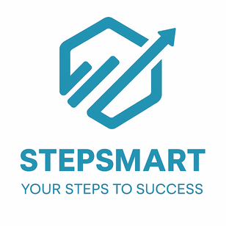
OUR PLAN OF ACTION
01
03
05
Guided Project
(With regular interactions with mentor)
Resources Distribution
Meet your mentors
Introductory Sessions
Flavor of Industry
Interview Preparation
Sessions
Mid
Assessments
Communication Sessions
Resume Preparation Sessions
In-Placement Support
(Adhoc - Session supporting students)
02
04
06
Your Step To Success

Slide 23
COMPARING STEPSMART TRAINING
Discover the unparalleled advantages of StepSmart over other training programs for your career success.
Personalized Learning
Industry Connections
Success Rates
Tailored programs for each individual.
Extensive partnerships with leading companies.
Proven track record of graduates' achievements.

Slide 24
ADD A CTA
Campys Ambassador
Notes:
Tata Consultancy Services (TCS) confirmed it could let go of up to 12,000 people this year, which is roughly 2% of its global headcount.
At the same time, HCL announced that junior employees get only a token 1-4% raise in salary, while mid-level employees have yet to get any. Infosys, the once voracious campus recruiter, onboarded just 210 people last quarter.
Microsoft is also laying off thousands of people in its Azure cloud unit. Intel is laying off 24,000 workers

